Slide 1


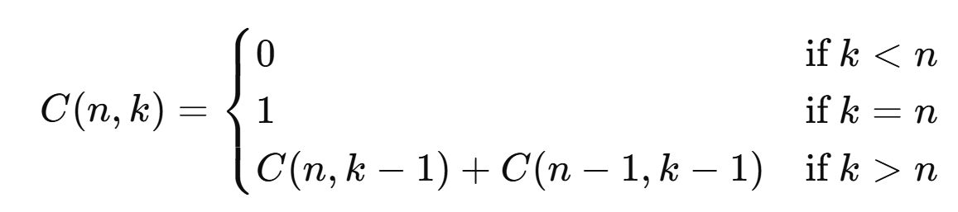
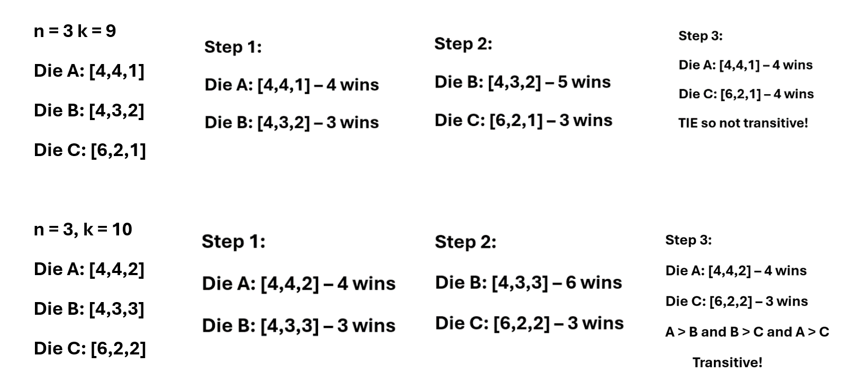
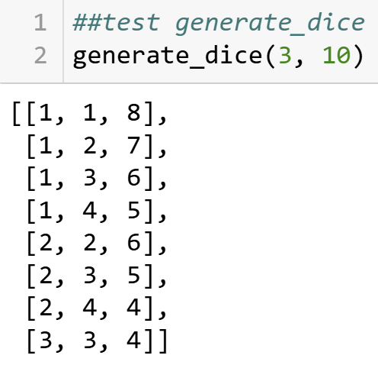
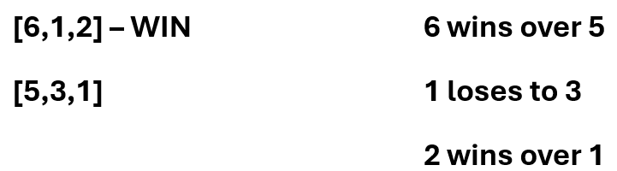
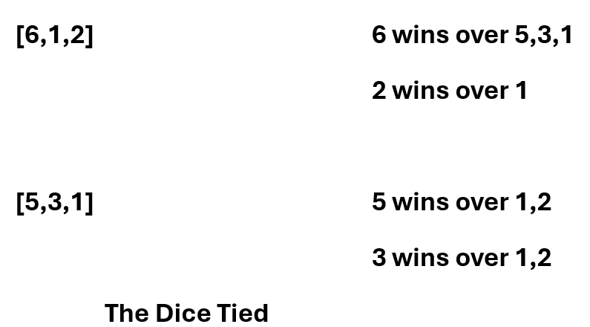
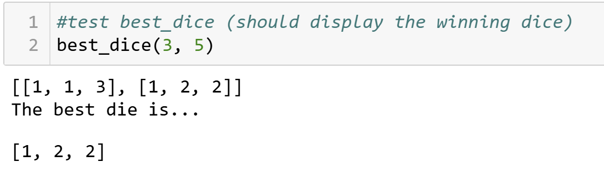
Combinatorial Analysis of Dice Configurations
Mary Kait Heeren, Dr. Jeremy Becnel
Department of Computer Science, Stephen F. Austin State University
Abstract
Transitivity
Bells Triangle Theorem
The intent of this exploration is to analyze the mathematical intricacies involved in constructing dice with n faces and k pips, with a focus on combinatorial analysis. The initial motivation stemmed from the development of a Python program designed to generate and compare dice configurations. This program served as a practical tool for visualizing die combinations and led to a deeper investigation into related mathematical concepts.
The investigation delves into the combinatorial aspects of dice configurations, examining how different setups influence the probability of winning. Additionally, it explores the concept of transitivity in dice relationships through examples and mathematical proofs, providing insights into the theoretical foundations of dice performance.
A relation is transitive whenever one element is related to a second element, and that second element is related to a third element, then the first element is also related to the third element.
In terms of dice:
If Die A beats Die B, and Die B beats Die C, then for transitivity to hold, Die A should also beat Die C.
As shown above, there are a few scenarios where transitivity remains true.
Above, is an example where transitivity fails, thus disproving the theory that dice follow transitivity rules for every case.
The Bell Triangle, also known as the Aitken Triangle, is a triangular array of numbers that generates Bell numbers, which count the number of ways to partition a set. The Bell numbers are found in the leftmost diagonal of the triangle. Using the concept of Bell's Triangle, we derived a recursive formula that determines the number of possible die combinations.
As an example, lets solve n = 3 and k = 4.
C(n,k) = C(n, k – 1) + C(n – 1, k – 1)
C(3,4) = C(3,3) + C(2,3)
C(2,3) = C(2,2) + C(1,2)
C(1,2) = C(1,1) + C(0,1)
C(0,1) = 0
Since C(3,3), C(2,2), and C(1,1) each represent one combination , there are 3 total combinations. We know to stop at C(0,1) because it results in 0 combinations added. To double check, we can write out each combination for n = 3 and k = 4 to verify the correct number of 3 combinations.
[1,1,2], [1,2,1], [2,1,1]
Although the Bell Triangle and the recursive function for dice combinations are not the exact same, they share a common combinatorial theme. Both involve the addition of previous elements in a structured way to build a larger combinatorial object. The Bell Triangle is specifically used for partitioning sets, but the recursive thinking it embodies is relevant to many areas of combinatorics, including the problem of counting dice configurations.
Program Implementation
The generate_dice method creates every possible arrangement of pips on a die with a specific number of faces and a total number of pips. It starts by finding all possible ways to divide the total number of pips into groups, where each group represents the pips on a face of the die. The method ensures that each face has at least one pip and checks each configuration to make sure it’s valid and unique. It then organizes these configurations and provides a list of all possible, distinct dice setups.
The best_dice method takes all the dice configurations created in the above method and compares each pair to see which one performs better. It does this by checking how often one die wins against another in a series of tests. For each pair, it counts the number of wins and ties.
After comparing all the dice, the method looks for the die that has the most wins and the fewest ties. This die is considered the best one based on these comparisons, and the method then selects and shows this top-performing die.
More Dice Comparisons
While exploring the transitive properties of dice, I discovered that there were multiple options when comparing dice that cause the results of transitivity to vary. An example of this would be comparing 1 face of the die to 1 face of the other die. This is referred to as the “overall strength” of the die.
Overall Strength Method:
Our Dice Comparison Method:
As shown in the two examples, the same two dice are being compared using two different methods to show that they will provide different comparison results. Upon further analyzation, it can be concluded that neither method shows transitivity amongst all cases.
Conclusion
Through the development of a python method for generating and comparing dice configurations, we observed transitivity does not universally hold amongst dice comparisons. We explored variations of comparison including “overall strength” versus “face-to-face” comparison and how outcomes will vary between both in regards to transitivity. We utilized the principle of the Bell Triangle to explore and quantify the number of possible dice configurations.
Overall, this research highlights the complexity of dice analysis that range from applications in programming to combinatorics. These results suggest an unconventional nature of dice and open the door for further investigation into the behavior of dice and their application in different environments.
Contact
Acknowledgements
References
Mary Kait Heeren
Department of Computer Science
P.O. Box 9837, SFA Station Nacogdoches, Texas 75962
heerenmk@jacks.sfasu.edu
This research was supported by the College of Sciences and Mathematics as part of the Undergraduate Research Experience at Stephen F. Austin State University. I’d like to extend a thank you to Stephen F. Austin State University and Jeremy Becnel for providing an opportunity to get involved in a Research Experience, as it has been an insightful and rewarding process.
Thank you to the Computer Science department for the workspace and the equipment used throughout the entirety of the project.
Geeks for Geeks (Aitken's Array or Bell Triangle - GeeksforGeeks)
Jupyter Notebook (Project Jupyter | Home)
Geeks for Geeks (Transitive Relations: Definition, Properties, and Examples (geeksforgeeks.org))

